Slide 1

DAY 09
Pointers, Strings and Structs
1

Slide 2
Intro
Syllabus
Pointers cont., Strings & String Class
HWK is 11.13 and 11.14*
HWK 11.8* and 11.11* due tonight midnight
Weds 10.12, 11.8* & 11.11*
NOTE: 11.8* and 11.11* due for 8 points per schedule on Feb 21.
1

Slide 3
Pointer Review
1

Slide 4

C++ Data Types
simple
structured
integral
enum
floating
array
struct
union
class
char short
int long bool
float double
long double
address
pointer
reference
9
9

Slide 5
Using a Pointer Variable
int x; x = 12;
2000
12
x
int* ptr; ptr = &x;
cout << *ptr;
3000
2000
ptr
9
9

Slide 6
Using the Dereference Operator
int x; x = 12;
2000
12
x
5
3000
int* ptr; ptr = &x;
2000
ptr
*ptr = 5;
9
9

Slide 7
Self –Test on Pointers
char ch; ch = ‘A’;
4000
A Z
ch
char* |  | q;
q | = | &ch;
*q | = | ‘Z’;
5000
6000
4000
4000
q
p
char* p; p = q;
9
9

Slide 8
Using a Pointer to Access the Elements of a String
char msg[ ] =“Hello”; char* ptr;
ptr = msg;
*ptr = ‘M’ ; ptr++;
*ptr = ‘a’;
msg
3000
‘H’ | ‘e’ | ‘l’ | ‘l’ | ‘o’ | ‘\0’
‘M’ | ‘a’
3001
3000
ptr
9
9

Slide 9
Operator new
char* ptr; ptr = new char;
*ptr = ‘B’;
cout << *ptr;
2000
5000
???
ptr
5000
‘B’
NOTE: Dynamic data has no variable name
9
9

Slide 10
STRINGS

Slide 11
Character Case Conversion
Require cctype header file
Functions:
toupper: if char argument is lowercase letter, return uppercase equivalent; otherwise, return input unchanged
char | ch1 | = | 'H';
char | ch2 | = | 'e';
char | ch3 | = | '!';
cout | << | toupper(ch1); |  | // | displays | 'H'
cout | << | toupper(ch2); |  | // | displays | 'E'
cout | << | toupper(ch3); |  | // | displays | '!'

Slide 12
Character Case Conversion
Functions:
tolower: if char argument is uppercase letter, return lowercase equivalent; otherwise, return input unchanged
char | ch1 | = | 'H';
char | ch2 | = | 'e';
char | ch3 | = | '!';
cout | << | tolower(ch1); |  | // | displays | 'h'
cout | << | tolower(ch2); |  | // | displays | 'e'
cout | << | tolower(ch3); |  | // | displays | '!'

Slide 13
C-Strings
C-string: sequence of characters stored in adjacent memory locations and terminated by NULL character
Array of chars can be used to define storage for string:
const int SIZE = 20
char city[SIZE];
String literal (string constant): sequence of characters enclosed in double quotes " " : "Hi there!"
H | i |  | t | h | e | r | e | ! | \0

Slide 14
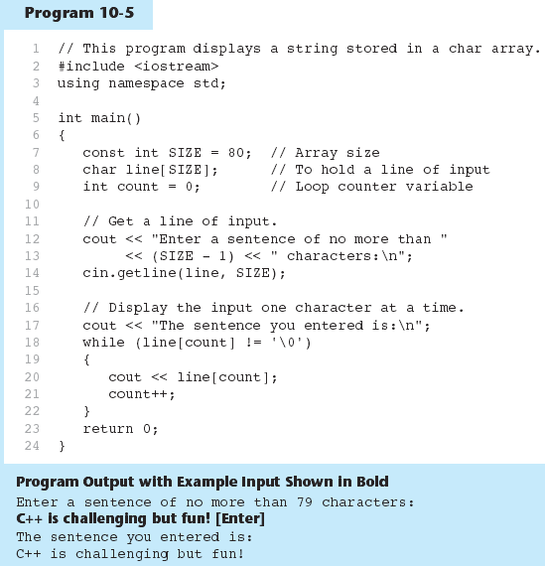
Using C-Strings in Program 10-5

Slide 15
Library Functions for Working with C-Strings
Functions:
strlen(str): returns length of C-string str
char city[SIZE] = "Missoula"; cout << strlen(city); // prints 8
strcat(str1, str2): appends str2 to the end of str1
char location[SIZE] = "Missoula, "; char state[3] = "MT";
strcat(location, state);
// location now has "Missoula, MT"

Slide 16
Library Functions for Working with C-Strings
Functions:
strlen(str)
char city[SIZE] = "Missoula"; cout << strlen(city); // prints 8
strcat(str1, str2)
char location[SIZE] = "Missoula, "; char state[3] = "MT";
strcat(location, state);
// location now has "Missoula, MT”
strcpy(str1, str2
const int SIZE = 20;
char fname[SIZE] = "Maureen", name[SIZE]; strcpy(name, fname);

Slide 17
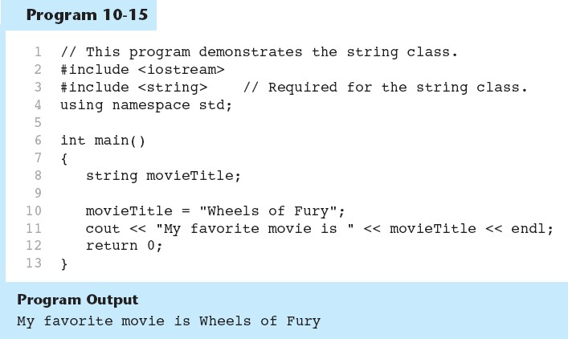
Using the string class in Program 10-15

Slide 18
string Member Functions
Are behind many overloaded operators
Categories:
assignment: assign, copy, data
modification: append, clear, erase, insert, replace, swap
space management: capacity, empty, length, resize, size
substrings: find, front, back, at, substr
comparison: compare
See Table 10-8 for a list of functions.

Slide 19
STRUCTS

Slide 20
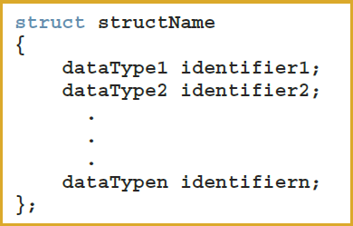
Records (structs) (1 of 3)
struct: a collection of a fixed number of components in which the components are accessed by name
The components may be of different types and are called the members of the
struct
Syntax

Slide 21



Records (structs) (1 of 3)
class X
{
public:
// stuff foo ...
};
struct X
{
// stuff foo ...
};
The only difference between a struct and class in C++ is the default accessibility of member variables and methods.
In a struct they are public; in a class they are private.

Slide 22


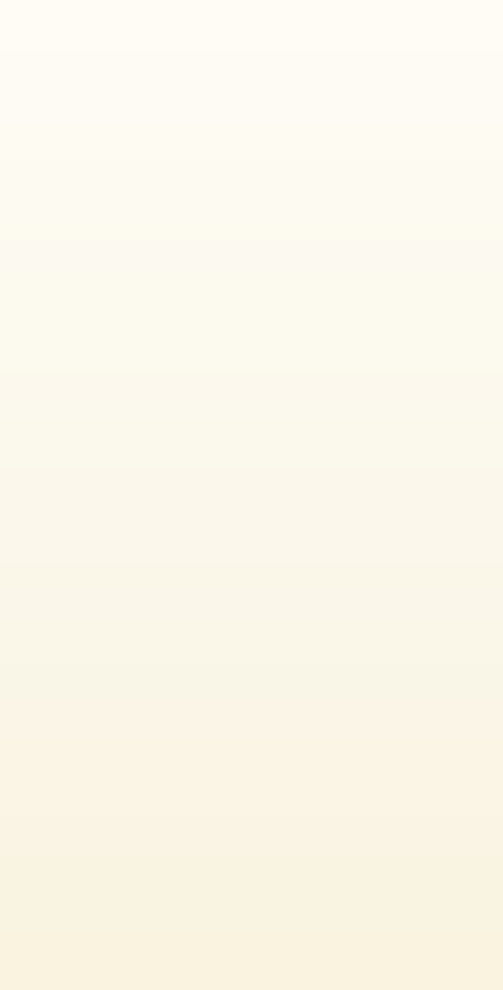
Records (structs) (1 of 3)
A compound statement consists of zero or more statements enclosed in curly braces ({ }).
class X
{
public:
// stuff foo ...
};
struct X
{
// stuff foo ...
};
SYNTAX
{ [ statement-list ] }
if( MidTermScore_CS3060 > 100 )
{
cout << ”You’re a rockstar no need to take CS3060 final\n";
Alert();
}
else
Grade -= MidTermScore_CS3060 ;

Slide 23
Records (structs) (2 of 3)
A struct is a
definition, not a declaration
Must declare a variable of that type to use it
struct houseType
{
//stuff about the foo house
};
//variable declaration houseType newHouse;

Slide 24
Records (structs) (2 of 3)
A struct is a definition, not a declaration
Must declare a variable of that type to use it
struct houseType
{
string style;
int numOfBedrooms; int numOfBathrooms; int numOfCarsGarage;
int yearBuilt;
int finishedSquareFootage; double price;
double tax;
};
//variable declaration houseType newHouse;

Slide 25
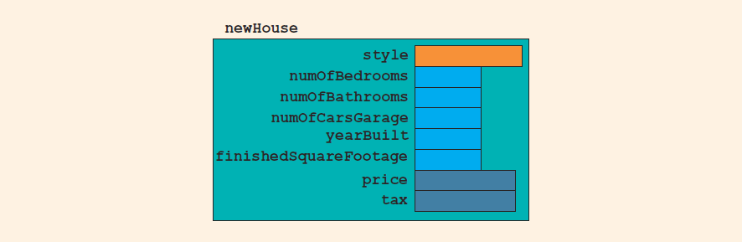
Records (structs) (3 of 3)
FIGURE 9-1 struct newHouse

Slide 26
Records (structs) (2 of 3)
You can declare a struct variable when you define the struct.
Must declare a variable of that type to use it
struct houseType
{
string style;
int numOfBedrooms; int numOfBathrooms; int numOfCarsGarage;
int yearBuilt;
int finishedSquareFootage; double price;
double tax;
} temphouse;

Slide 27
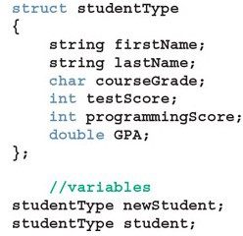

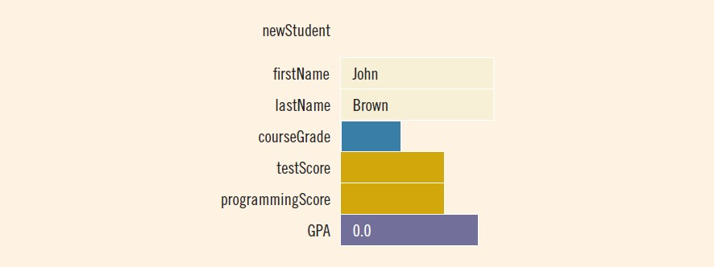
Accessing struct Members (1 of 2)
Syntax to access a struct member:
To initialize the members of newStudent:
newStudent
.GPA = 0.0;
.firstName = "John";
.lastName = "Brown";
newStudent
newStudent
FIGURE 9-2 struct newStudent

Slide 28
Assignment (1 of 2)
Value of one struct variable can be assigned to another struct variable of the same type using an assignment statement
The statement:
student = newStudent;
copies the contents of newStudent into student

Slide 29
Assignment (2 of 2)
The assignment statement:
student = newStudent;
is equivalent to the following statements:
student
student
student
student
student
student
.firstName = .firstName;
newStudent
.lastName = .lastName;
newStudent
.courseGrade =
newStudent
.courseGrade;
.testScore =
newStudent
.testScore;
.programmingScore =
newStudent
.programmingScore;
.GPA = newStudent.GPA;

Slide 30
Comparison (Relational Operators)
Compare struct variables member-wise
No aggregate relational operations are allowed
To compare the values of student and newStudent:
if (student.firstName == newStudent.firstName && student.lastName == newStudent.lastName)
.
.
.

Slide 31
Comparison (Relational Operators)
Compare struct variables member-wise
No aggregate relational operations are allowed
QUESTION
How do we compare the values of student and newStudent:

Slide 32

Comparison (Relational Operators)
To compare the values of student and newStudent:
if (student.firstName == newStudent.firstName && student.lastName == newStudent.lastName)
.
.
.
BUT is this legal?

Slide 33
Comparison (Relational Operators)
BUT is this legal?

Slide 34
Input/Output
No aggregate input/output operations are allowed on a struct variable
Data in a struct variable must be read or written one member at a time
QUESTION
How do we output newStudent contents:

Slide 35
Input/Output
The following code would output newStudent contents:
cout << newStudent.firstName
<< | " | " | << | newStudent.lastName
<< | " | " | << | newStudent.courseGrade
<< | " | " | << | newStudent.testScore
<< | " | " | << | newStudent.programmingScore
<< | " | " | << | newStudent.GPA << endl;

Slide 36
struct Variables and Functions
A struct variable can be passed as a parameter by value or by reference
A function can return a value of type struct
QUESTION
Write a function displays the contents a struct variable of type studentType::

Slide 37
struct Variables and Functions
The following function displays the contents a struct variable of type
studentType:
void printStudent(studentType student)
{
cout << student.firstName << " " << student.lastName
<< " " << student.courseGrade
<< " " << student.testScore
<< " " << student.programmingScore
<< " " << student.GPA << endl;
}

Slide 38
struct Variables and Functions
cout << newStudent.firstName << " " << newStudent.lastName
<< " " << newStudent.courseGrade
<< " " << newStudent.testScore
<< " " << newStudent.programmingScore
<< " " << newStudent.GPA << endl;
void printStudent(studentType student)
{
cout << student.firstName << " " << student.lastName
<< " " << student.courseGrade
<< " " << student.testScore
<< " " << student.programmingScore
<< " " << student.GPA << endl;
}

Slide 39
Arrays versus structs
TABLE 9-1 Arrays vs. structs
Data Type | Array | struct
Arithmetic | No | No
Assignment | No | Yes
Input/output | No (except strings) | No
Comparison | No | No
Parameter passing | By reference only | By value or by reference
Function returning a value | No | Yes

Slide 40
Arrays in structs (1 of 3)
Two items are associated with a list:
Values (elements)
Length of the list
Define a struct containing both items:
const int ARRAY_SIZE = 1000; struct listType
{
int listElem[ARRAY_SIZE]; int listLength;
};
//array containing the list
//length of the list

Slide 41
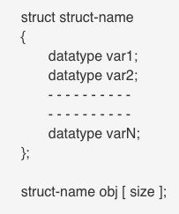
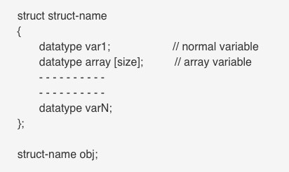
Array within Structure
Array of Structure

Slide 42
Array of Structure

Slide 43
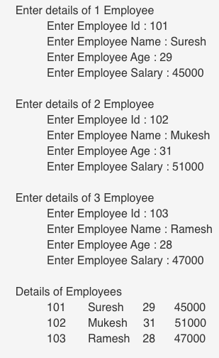
#include<iostream.h> struct Employee
Array of Structure
{
int Id;
char Name[25];
int Age;
long Salary;
};
void main()
{
int i;
Employee Emp[ 3 ];
//Statement 1
for(i=0;i<3;i++)
{
cout << "\nEnter details of " << i+1 << " Employee"; cout << "\n\tEnter Employee Id : ";
cin >> Emp[i].Id;
cout << "\n\tEnter Employee Name : ";
cin >> Emp[i].Name;
cout << "\n\tEnter Employee Age : "; cin >> Emp[i].Age;
cout << "\n\tEnter Employee Salary : "; cin >> Emp[i].Salary;
}
cout << "\nDetails of Employees";
for(i=0;i<3;i++)
cout << "\n"<< Emp[i].Id <<"\t"<< Emp[i].Name <<"\t"
<< Emp[i].Age <<"\t"<< Emp[i].Salary; }

Slide 44
Array within Structure

Slide 45
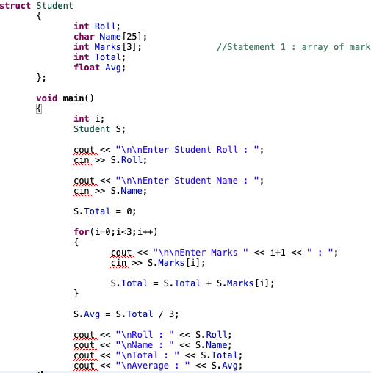
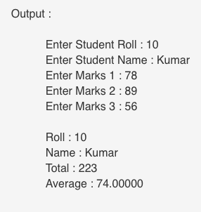
Array within Structure

Slide 46
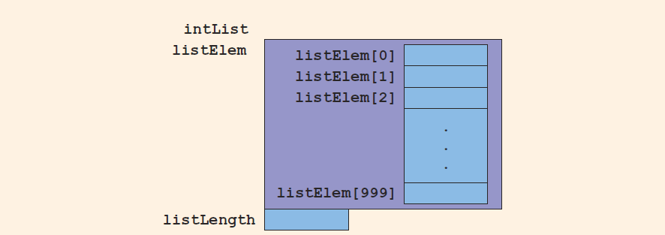
Arrays in structs (2 of 3)
FIGURE 9-5 struct variable intList

Slide 47
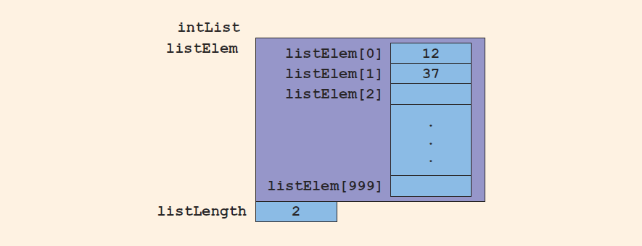
Arrays in structs (3 of 3)
Consider these statements and refer to the figure below showing the results following execution of the statements:
intList.listLength = 0; | //Line | 1
intList.listElem[0] = 12; | //Line | 2
intList.listLength++; | //Line | 3
intList.listElem[1] = 37; | //Line | 4
intList.listLength++; | //Line | 5
FIGURE 9-6 intList after the statements in Lines 1 through 5 execute

Slide 48
structs in Arrays (1 of 2)
Example
struct employeeType
{
// employee members components stuff
};
First, let’s define an employee’s record:
Each employee has the following members (components): first name, last name, personal ID, department ID, yearly salary, monthly salary, year-to-date paid, and monthly bonus.
Give it a try, what will be string, int double

Slide 49
structs in Arrays (1 of 2)
Example
struct employeeType
{
string firstName; string lastName; int personID; string deptID; double yearlySalary; double monthlySalary
double yearToDatePaid;
double monthlyBonus;
};

Slide 50
Quick Review (2 of 2)
In C++, the dot (.) operator is called the member access operator
Used to access members of a struct
The only built-in operations on a struct are the assignment and member access operations
Neither arithmetic nor relational operations are allowed on structs
A struct can be passed by value or reference
A function can return a value of type struct
A struct can be a member of another struct

